Slide 1










ASP.Net edition
see you in the fall for our next edition
your sponsors
Get a FREE O’Reilly ebook of your choice! Limit one per person per event: http://bit.ly/DenverDevDay
Free program dedicated to startups. Software & Tools to build apps. You are invited, join: www.microsoft.com/bizspark

Slide 2

Introduction to ASP.NET MVC
Joe Wilson,
Volare Systems, Inc.
volaresystems.com/blog
@joe_in_denver

Slide 3
Agenda
Where does MVC fit in today’s web?
Basics of MVC
Routing
Views
Controllers/Actions
Models
MVC: The good parts
Is MVC a fit for your project?

Slide 4
Today’s web, same old HTTP
Request
GET, POST

 
Browser Client
Response
HTML, JSON, File, XML
Web
Server

Slide 5



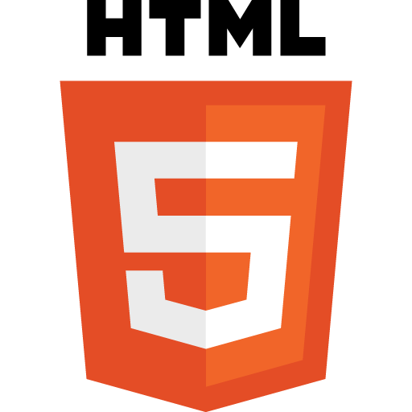

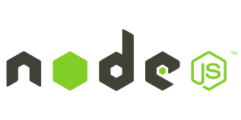




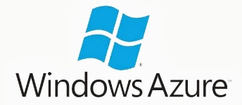



Today’s web, more abstractions, libraries, frameworks on top of HTTP
Request
GET, POST
Web Forms
MVC
Web API

 
Response
HTML, JSON, File, XML

Slide 6
Basics of MVC
M = Model
V = View
C = Controller
(R = Routing)

Slide 7
Basics of MVC - Routing
Controller
Action
http://server/product/edit

 
Request
Browser Client
Response
Web
Server
HTML, JSON, File, XML

Slide 8
Basics of MVC - Routing

Request (GET or POST)
Routing Engine
Controller (Action)
Response
View,
JSON, File,
XML
Model

Slide 9
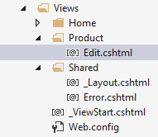
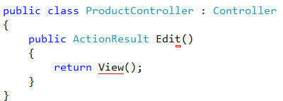
Basics of MVC - Routing
Controller
Action
http://server/product/edit
Folder
View

Slide 10
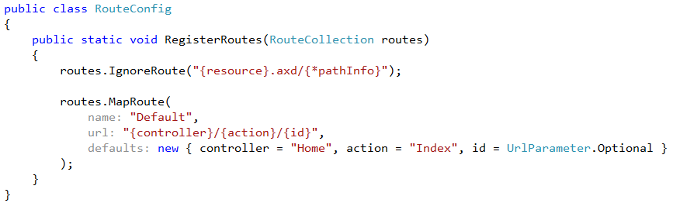
Basics of MVC – Routing (Default route)

Slide 11
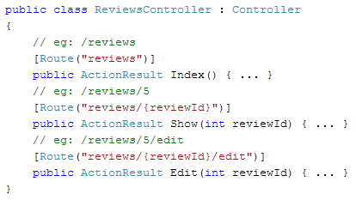
Basics of MVC – Routing (Route attributes)

Slide 12
Demo - Routing

Slide 13
Basics of MVC – Views
Are .CSHTML files
Hold user interface elements (HTML, CSS, JavaScript)
Use _Layout.cshtml to style pages the same for entire app
Show Model data with @Model.Something or @ViewBag.Something
Views should not contain much logic
Simple “if”s or “foreach”es are OK

Slide 14
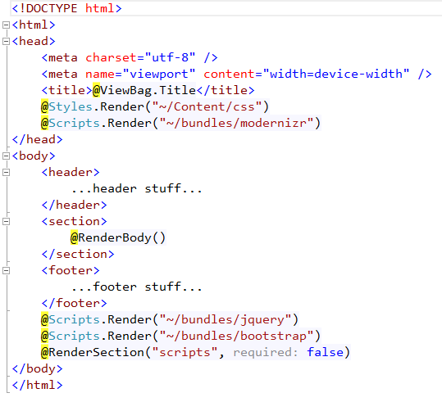
Basics of MVC – Views (_Layout.cshtml)

Slide 15
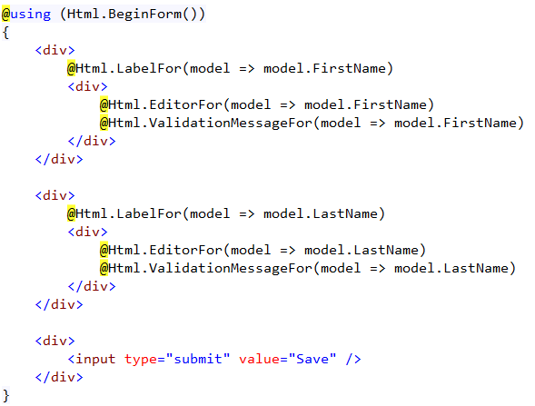
Basics of MVC – Views (Edit form)

Slide 16
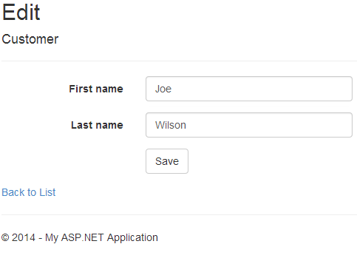
Basics of MVC – Views

Slide 17
Basics of MVC – Controllers
Are .CS files
Hold commands and workflows in Actions (methods)
Model bind values from form, query string, cookies, etc.
Works with Models for small logic and data
Validate user input before moving on
Render Views, JSON, XML, RSS, File, etc.

Slide 18
Basics of MVC – Models
Are .CS files or ViewBag, which is a dynamic type
Can be TempData[“something”] for single-use values
Data to display in the View and data posted from the View back to the Controller
Good place for validation attributes
Good place for light, display-related logic (Full Name, Totals, IsUserLoggedIn, etc.)

Slide 19
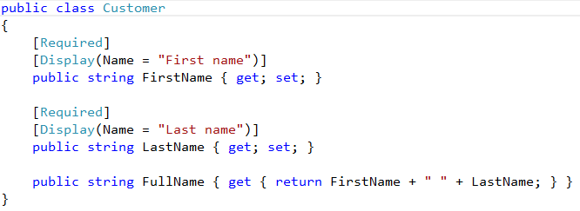
Basics of MVC – Validation and Scaffolding

Slide 20
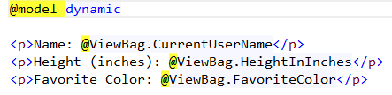

Basics of MVC – Models (ViewBag)
In Controller/Action..
In View….

Slide 21
Demo – Views, Models, Scaffolding and Model Binding

Slide 22


Basics of MVC – Security
Security
Attributes on controller and/or action
Allow Anonymous is the default

Slide 23
Demo – Security

Slide 24
MVC: The good parts
Separation of Concerns guidance
Don’t dump all your code in HTML or code behind files
MVC gives guidance about what kind of code goes where
Convention over configuration

Slide 25
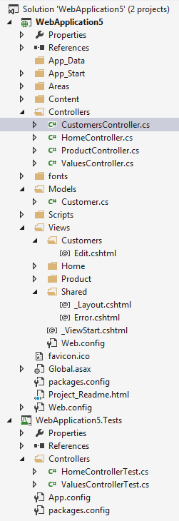
MVC: The good parts
Style Sheets, Images
Controllers
Models
JavaScript
Views
Layout
Tests

Slide 26
MVC: The good parts
Testability
Putting as much logic as possible in POCOs leads to easier testing
HttpContext is hard to mock
MVC provides mockable abstract classes

Slide 27
MVC: The good parts
Clean HTML
MVC controls keep their IDs
Easier to manipulate DOM with JavaScript and jQuery
Easier to build accessible, Section 508 compliant sites

Slide 28
MVC: The good parts
HTML from Web Forms
<span id="ctl00_MainContent_uxdPHAllContent_TripSelector_lblFromDate">
From Date:</span>
<input type="text" name="ctl00$MainContent$uxdPHAllContent$TripSelector$txtFromDate" id="ctl00_MainContent_uxdPHAllContent_TripSelector_txtFromDate" />
HTML from MVC
<label for="FromDate">From Date:</label>
<input type="text" name="FromDate" id="FromDate" />

Slide 29
MVC: The good parts
Clean URLs
MVC and Web API have more hackable, SEO-friendly URLs
URLs with or without query strings

Slide 30
MVC: The good parts
URLs with query strings
http://mysite.com/Shop.aspx?Category=Shirts
http://mysite.com/Shop.aspx?ID=123
URLs in MVC and Web API
http://mysite.com/Shop/Category/Shirts
http://mysite.com/Shop/ID/123

Slide 31
MVC: The good parts
Headroom
Extensible
Custom Routing
Custom View Engine
Custom Model/Parameter Binders
Custom Action Filters
Custom Formatters
All code is released as open source

Slide 32
MVC: The good parts
Part of ASP.NET, same security model
Can run side-by-side with Web Forms, SignalR, etc.
Cookies, Session, Caching, etc. still work the same

Slide 33
Today’s web, where does MVC fit?
ASP.NET security for pages
Consistent look with a Layout page
Model binding, server-side validation
Easy to send data from the server with the view

Slide 34
Resources
Microsoft site for MVC - asp.net/mvc
Microsoft site for Web API - asp.net/web-api
Pluralsight - pluralsight.com
volaresystems.com/blog
@joe_in_denver

